Slide 1
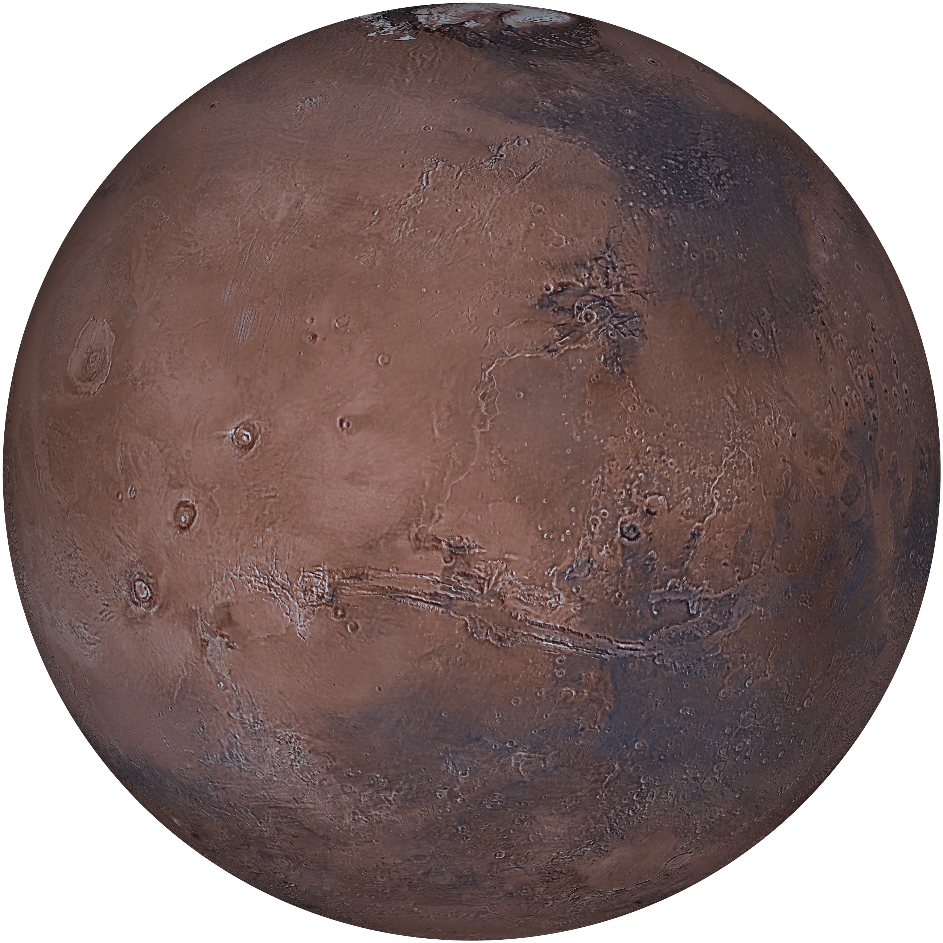
Mars Global Mosaic
REMOTE SENSING 2026 OCN 4704
Logan Edwards

Slide 2
GOALS AND MISSION
Background
02
Assemble a co-registered global visible and thermal-infrared mosaic of Mars with altimetric data in ArcGIS Pro from three existing global products, and use it to map and classify three primary landform families (volcanic flow units, fluvial channels and valley networks, and impact craters) producing one internally consistent global landform inventory.
01
Three consumer-level(less then 1TB) global products cover Mars end to end, in three parts of the spectrum. No single product lets you interrogate morphology, thermal response, and slope at the same pixel; building that stack is the core technical task.
02
Each target landform family records a different process (volcanic resurfacing, flowing water, impact) and each is expressed differently across the three datasets. That is what makes fusing them worth doing.
Mars Global Mosaic · OCN 4704

Slide 3
Significance of the Mission
03
01
Thermal infrared responds to particle size and surface coherence; visible albedo does not. Where Mars is dust-mantled, the THEMIS layer should recover flow boundaries the Viking mosaic cannot; a claim this project can measure.
02
Discriminating volcanic from fluvial channels is a live problem: Athabasca Valles was mapped as a fluvial outflow channel for decades before being reinterpreted as flood lava. Morphology plus thermal response addresses it.
03
Testable without privileged data: unit boundaries against the published USGS global geologic map, crater rims against the 141 IAU-named craters above 100 km already in the geodatabase.
Mars Global Mosaic · OCN 4704

Slide 4
Tasks Required
04
#
TASK
WHAT IT INVOLVES
1
Acquire the global raster set
Done. All three on disk with statistics built; pyramids still to build.
2
Build a grouped mosaic viewer
Done. One map, three groups, each source raster paired with its derived product.
3
Rebuild the terrain derivatives
Re-run Slope and Hillshade on the projected DEM for a valid z-factor.
4
Build the visible + infrared composite
Composite Bands over Viking colour and THEMIS day; four bands. Project first, then run over bounded extents.
5
Derive image-gradient products
Edge and texture from DN, labelled as gradient rather than as terrain slope.
6
Classify surface units
Iso Cluster, then Maximum Likelihood on training polygons. Already rehearsed on the Mercury MESSENGER basemap.
7
Digitize landform vectors
Flow margins, channel centerlines and crater rims as three feature classes.
8
Build a real crater inventory
The IAU layers are a gazetteer of 1,113 named craters. Digitize a sample area or import a catalogue.
9
Produce the map layouts
None exist yet. Global sheets at 60°N–60°S plus detail panels.
Mars Global Mosaic · OCN 4704

Slide 5
Which Spectral Bands and Why
05
BAND OR PRODUCT
WAVELENGTH
WHY THIS BAND
THEMIS Day IR (v12 mosaic)
6.8–14.9 µm
The morphology and composition base, and the finest global layer held
Viking MDIM 2.1 band 1 (red)
≈ 0.59 µm
Best contrast between ferric dust and darker basalt
Viking MDIM 2.1 bands 1/2/3
visible RGB
Natural-colur context and unit boundary confirmation
HRSC/MOLA elevation
n/a (altimetry)
The vertical reference for every channel gradient measured
Mars Global Mosaic · OCN 4704

Slide 6
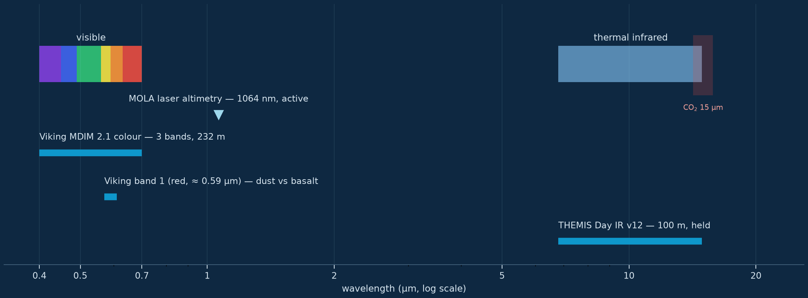
Which Part of the Electromagnetic Spectrum
06
Mars Global Mosaic · OCN 4704

Slide 7
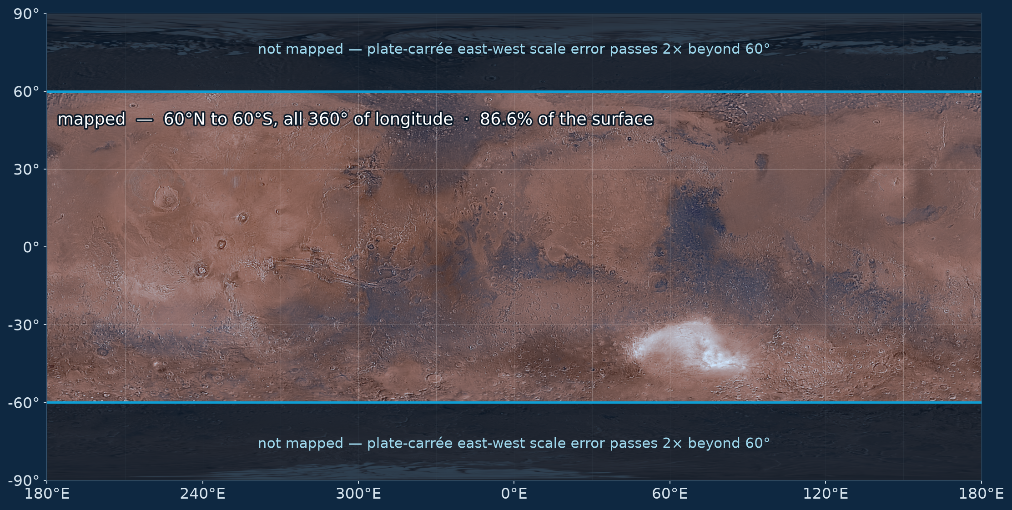
Mapping Extent
07
Mars Global Mosaic · OCN 4704

Slide 8
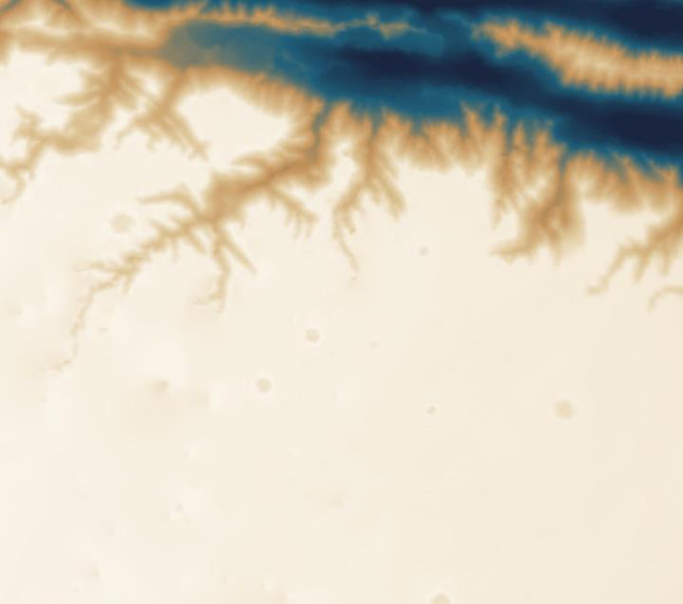
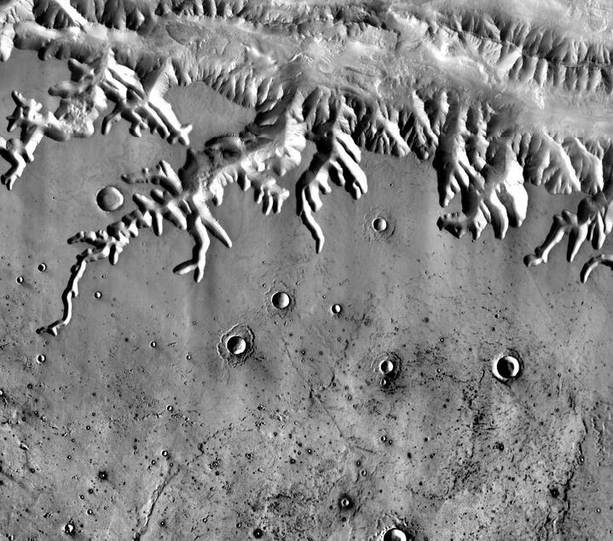
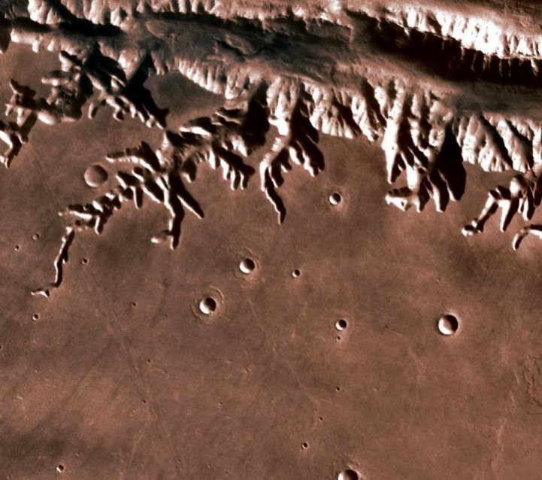
Data Sources
08
HRSC_MOLA_BlendDEM_200m
Elevation · 200 m/px · 106,694 × 53,347
MO_THEMIS-IR-Day_100m
Thermal IR · 100 m/px · 213,390 × 106,696
Viking_MDIM21_232m
Visible color · 232 m/px · 92,160 × 46,080 · 3 bands
Mars Global Mosaic · OCN 4704

Slide 9
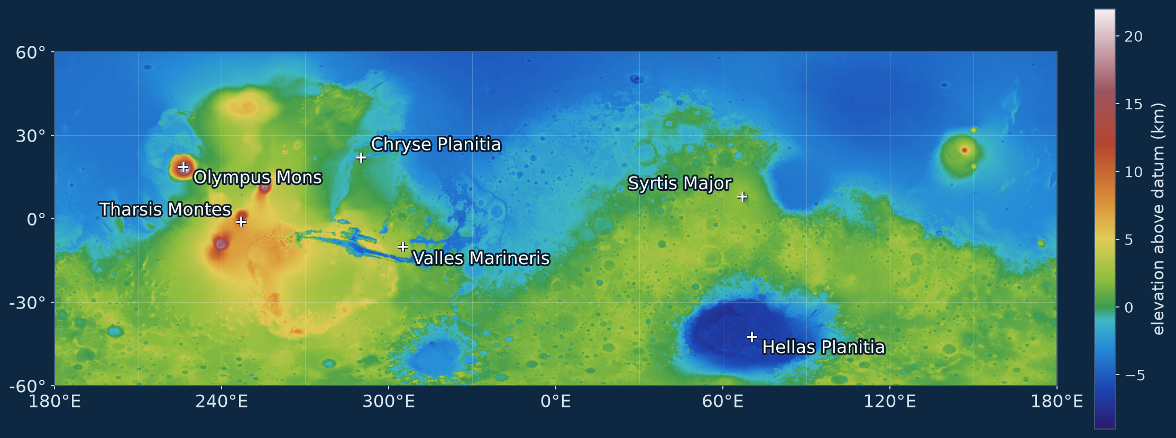
THE VERTICAL REFERENCE
HRSC/MOLA Blended DEM
09
200 m/px, 106,694 × 53,347, 16-bit. Measured relief −8,528 m to +21,226 m, 29,754 m from the Hellas floor to the Olympus Mons summit.
Mars Global Mosaic · OCN 4704

Slide 10
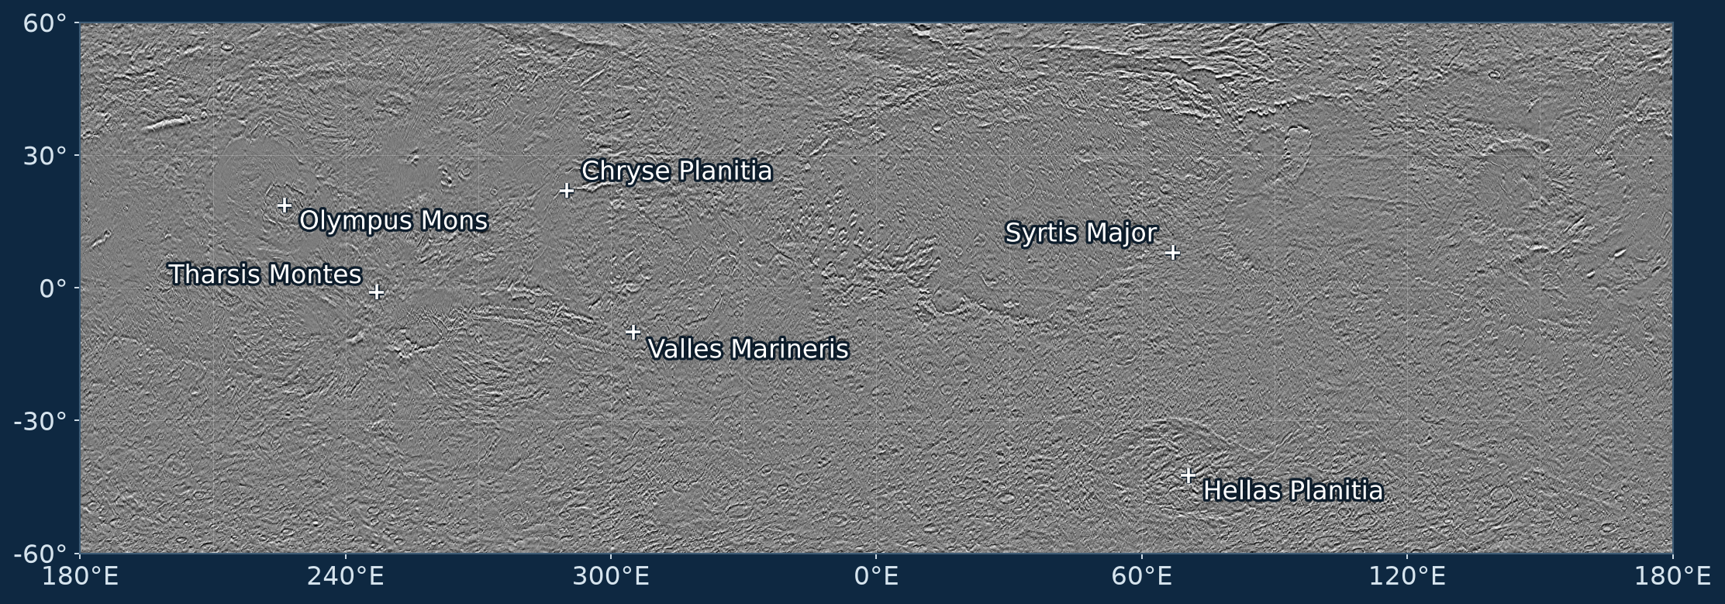
THE 100 M THERMAL BASE
THEMIS Day IR
10
100 m/px, 213,390 × 106,696, 22.77 billion pixels, of which 22.14 billion are valid (97.3% coverage). Rolled from central meridian 180° onto 0° so it registers against the other two.
Mars Global Mosaic · OCN 4704

Slide 11
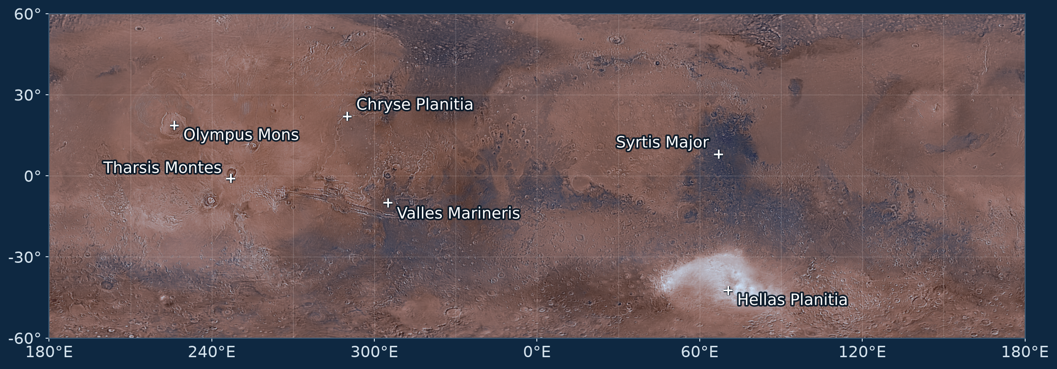
THE VISIBLE BASE
Viking MDIM 2.1
11
232 m/px, 92,160 × 46,080, three bands.
Mars Global Mosaic · OCN 4704

Slide 12
Resolution
12
SPATIAL
SPECTRAL
RADIOMETRIC
Set by what is held: 100 m (THEMIS), 200 m (DEM), 232 m (Viking). The composite can be no finer than its coarsest input.
Four bands held: one thermal, three visible. Enough to separate broad unit types, not enough to identify minerals.
Both image mosaics are 8-bit as distributed, the practical limit on how finely units can be separated by DN alone.
Ten pixels across a feature to map its margin reliably; so features of about a kilometer and up. Sub-kilometer tributaries will not resolve.
The DEM is the exception, carrying a real range of −8,528 m to +21,226 m. The quantitative measurements come from there.
Temporal Resolution: Not relevant as changes in our time scale would be of negligible observability
Mars Global Mosaic · OCN 4704

Slide 13
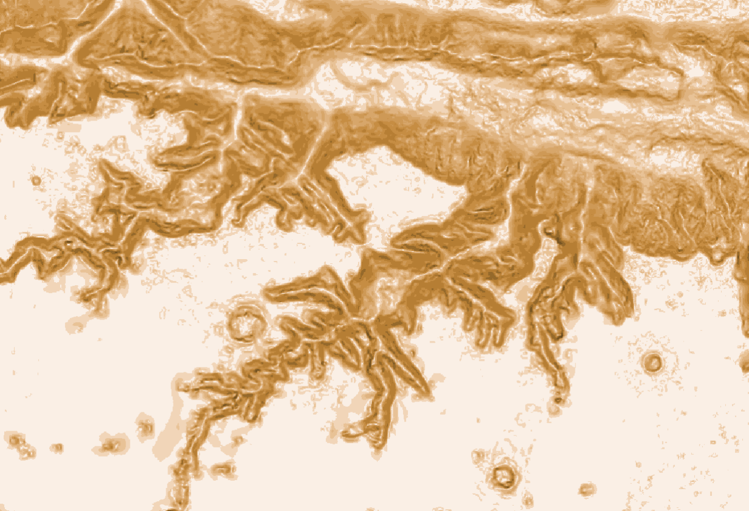
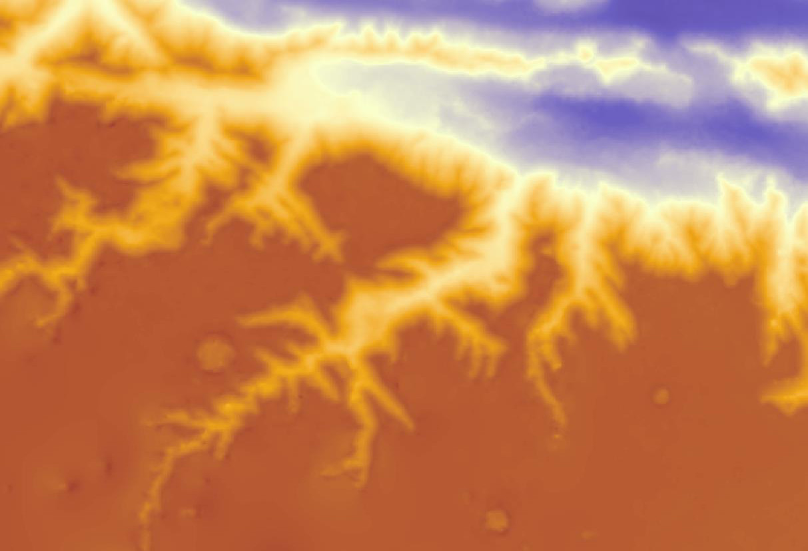
Slope from Elevation
13
Slope Analysis
Mars HRSC MOLA BlendDEM Global 200mp
Mars Global Mosaic · OCN 4704

Slide 14
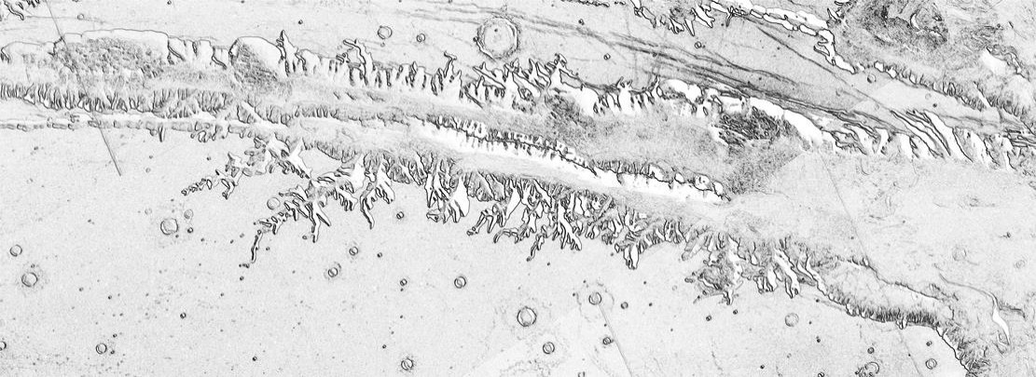
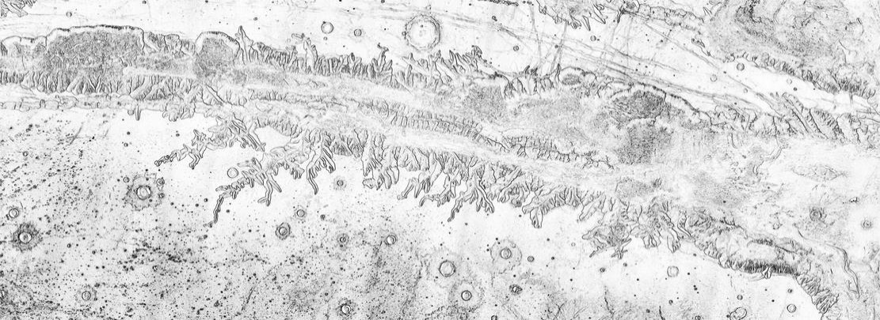
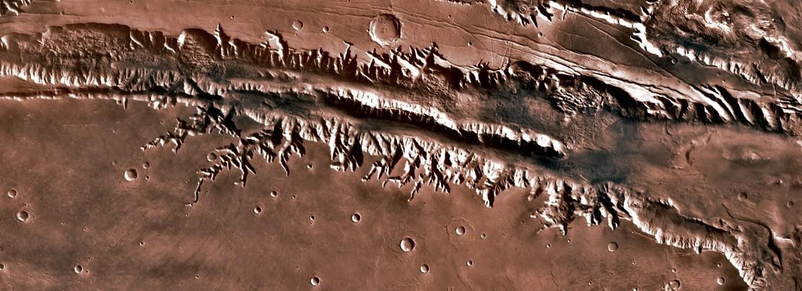
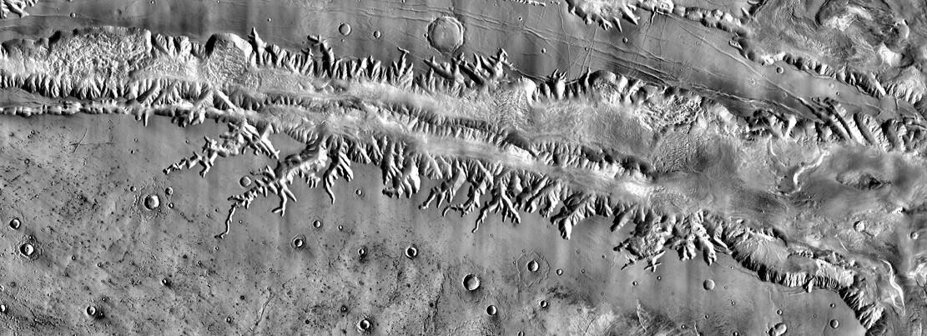
Gradient Products
14
Viking MDIM 2.1
THEMIS Day IR
Mars Global Mosaic · OCN 4704

Slide 15
WHAT THIS PRODUCES
Expected Results
15
01
One co-registered stack. Viking RGB and THEMIS day IR in a single 232 m metric frame, with the DEM and a rebuilt slope layer readable at the same pixel.
02
A classified unit raster. Iso Cluster then Maximum Likelihood over that stack; five to eight units expected to survive inspection against the imagery.
03
Three primary landform feature classes. Flow margins, channel centerlines and crater rims as separate vectors, each carrying DEM gradient along its length.
04
A measured band comparison. The fraction of flow margin THEMIS recovers and Viking does not, quantified over a dust-mantled type area rather than asserted.
05
Map sheets. Global layouts at 60°N–60°S plus detail panels, with unit boundaries overlaid on the USGS global geologic map.
Mars Global Mosaic · OCN 4704

Slide 16
FALSIFIABLE CLAIMS
Hypotheses to be Tested
16
H1
Thermal infrared recovers flow boundaries that visible albedo cannot.
Tested by digitizing margins on THEMIS and on Viking independently over one dust-mantled window; falsified if THEMIS adds nothing Viking already shows.
H2
Volcanic and fluvial channels separate on thermal response and long profile.
Tested on Athabasca Valles, long mapped as fluvial and reinterpreted as flood lava, against a known valley network; falsified if the signatures overlap.
H3
The four-band stack classifies surface units better than any single band.
Tested by running Maximum Likelihood on the stack and on THEMIS alone and scoring both against the published USGS contacts.
H4
At a 100 m floor the landform inventory is size-biased, not just incomplete.
Tested on the size-frequency distribution of mapped channels, which should roll over near 1 km rather than continue as a power law.
Mars Global Mosaic · OCN 4704

Slide 17
OPEN AT THIS STAGE
Questions to be Answered
17
01
What fraction of the THEMIS flow-margin network is also recoverable from Viking?
Answered by digitizing both over one window and differencing.
02
Can Athabasca Valles be called lava rather than water from these three products?
Answered from the four-band signature and the DEM long profile.
03
What is the smallest landform this stack maps reliably?
Answered from where the channel and crater populations roll over.
04
Where does the classification disagree with the USGS geologic map?
Answered by overlaying unit boundaries on the published contacts.
Mars Global Mosaic · OCN 4704

Slide 18
Potential Problems
18
Processing time is the schedule: 1 h 27 min for surface parameters on Viking MDIM alone
no sub-meter imagery: The finest imagery held is 100 m, as research grade 5 m imagery is over 10 TB of data. Even if it can be stored, processing time would be measured in days for simple tasks (Hence Consumer vs Researcher grade)
Three coordinate frames: THEMIS day IR sits on central meridian 180° while Viking and the DEM sit on 0°, and the DEM is on a degree grid while both mosaics are metric. A mismatch here misregisters silently rather than failing.
No ground truth: the USGS geologic map and the IAU gazetteer are the only references, and the gazetteer is a names list (141 craters above 100 km) not a crater inventory.
Mars Global Mosaic · OCN 4704

Slide 19
PLAN TO DELIVERY
Project Schedule
19
Sep
Oct
Nov
Dec
7
14
21
28
5
12
19
26
2
9
16
23
30
7
Rasters acquired, viewer built
Build raster pyramids
Reproject into one frame
Rebuild slope and hillshade
Composite Bands: four-band stack
Image-gradient products
Classify surface units
Digitize landform vectors
Crater inventory
Map layouts and final deck
TODAY
Complete
Planned
Mars Global Mosaic · OCN 4704

Slide 20
Where This Stands
20
01
Three global rasters on disk, characterized from the files themselves; 43.7 GB, 100–232 m/px, one of them 22.8 billion pixels.
02
The mapped extent is settled: all 360° of longitude between 60°N and 60°S, which is 86.6% of the surface and caps plate-carrée scale error at a factor of two.
03
Next: project everything into one frame, rebuild slope and hillshade, then run Composite Bands to conjoin different data
04
The whole plan is testable without privileged data; the USGS global geologic map and the IAU gazetteer are the references, and the 100 m floor is stated as a limit rather than worked around.
Mars Global Mosaic · OCN 4704

